Slide 1
Chapter 9: Leslie Matrix Models & Eigenvalues
(9.1) Leslie Matrix Models
(9.2) Long Term Growth Rate (Eigenvalues)
(9.3) Long Term Population Structure (Corresponding Eigenvectors)

Slide 2
Introduction
1. (9.1) Leslie Matrix Models
In the models presented and discussed in Chapters 6, 7, and 8, nothing is created or destroyed:
In the landscape succession examples, we never created or destroyed land; the land merely changed from one state to another
In the disease model, there were no births or deaths; individuals merely moved between infected and susceptible states
In this chapter we discuss models which take into account births and deaths

Slide 3
Motivating Example: Locusts
1. (9.1) Leslie Matrix Models
Suppose we are studying a population of locusts and want to know how their population changes over time:
Locust have three stages in their life cycle:
(1) egg
(2) nymph or hopper
(3) adult
Not all locust eggs will survive to become adults:
Some will die while they are still eggs
Others will die while they are hoppers
Locusts are only able to reproduce (lay eggs) during the adult stage of their life

Slide 4
Motivating Example: Locusts
1. (9.1) Leslie Matrix Models
Suppose in the particular population of locusts we are studying, each year:
2% of the eggs survive to become hoppers
5% of the hoppers survive to become adults
Adults die soon after they reproduce (i.e. they do not survive to the next year)
Additionally, the average female adult locust will produce 1000 eggs before she dies

Slide 5
Motivating Example: Locusts
1. (9.1) Leslie Matrix Models
Since it is the females that reproduce, we model only the females of the population:
Let x₁(t) be the number of female eggs in the locust population at time step t
Let x₂(t) be the number of female hoppers in the locust population at time step t
Let x₃(t) be the number of female adults in the locust population at time step t

Slide 6
Motivating Example: Locusts
1. (9.1) Leslie Matrix Models
We can write a system of equations to represent how this population changes each year:
As before, we express this as a matrix equation:
Now, as in the previous chapters, we are able to find how the population changes over time

Slide 7
Example 9.1 (Six Years of Locusts)
1. (9.1) Leslie Matrix Models
How does the population of locusts change over the course of six years if there are only 50 adults at the initial time (no eggs and no hoppers)?
Solution: Our initial population vector is . We want to find:
We will use MATLAB to make these calculations:

Slide 8
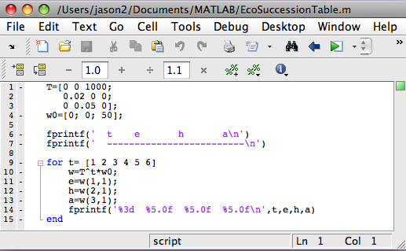
Example 9.1 (Six Years of Locusts)
1. (9.1) Leslie Matrix Models
Here I have simply modified the file “EcoSuccessionTable” to fit our problem:

Slide 9
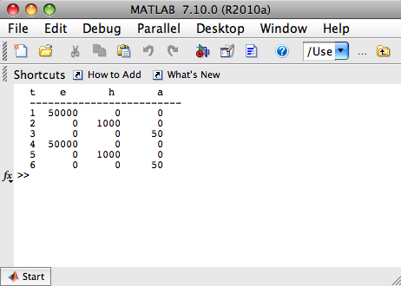
Example 9.1 (Six Years of Locusts)
1. (9.1) Leslie Matrix Models
Running this script, we get the output in the Command Window:
Interestingly, we see
that the locust
population cycles
every 3 years.

Slide 10
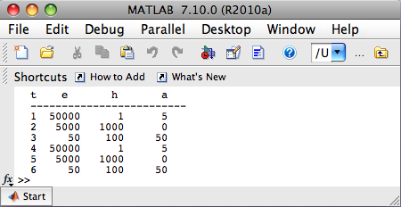
Example 9.1 (Six Years of Locusts)
1. (9.1) Leslie Matrix Models
(b) How does the population of locusts change over the course of six years if there are 50 eggs, 100 hoppers, and 50 adults at the initial time?
Solution: Our initial population vector is . Simply modifying and running the script, we get the output:
The population still
cycles every 3 years,
but the numbers are
different.

Slide 11
Leslie Matrices
1. (9.1) Leslie Matrix Models
This type of matrix population model is known as a Leslie matrix model. In general, Leslie matrices have the form:
f_{i} is the average number of female offspring born to a female individual per time step in class i
s_{i} is the percent of individuals in class i that survive to class i+1, for i < n per time step; for i = n, s_{n} is the proportion of individuals in class n who survive subsequent time periods
f_{i} is the fecundity rate, and s_{i} the survival rate
Note that the ﬁrst row gives the equation corresponding to the ﬁrst age class x₁ (like newborn)

Slide 12
Example 9.2 (American Bison)
1. (9.1) Leslie Matrix Models
The Leslie matrix for the American Bison is given by:
The population is divided into calves, yearlings, and adults (ages two or more)
Thus, females who reach the age of 2 years survive an additional year with probability 0.95 and reproduce with the same regularity
If we start a herd with 100 adult females, what will the herd population structure look like for the subsequent five years?

Slide 13
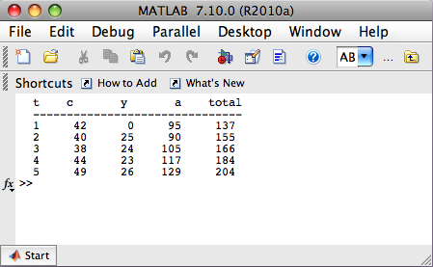
Example 9.2 (American Bison)
1. (9.1) Leslie Matrix Models
Solution: Our initial population vector is .
Simply modifying and running the script, we get the output:
Notice that I have
added a total column.
The female population
is growing.

Slide 14
Introduction
2. (9.2) Long Term Growth Rate (Eigenvalues)
Given a Leslie matrix, we would like to find a stable stage distribution; that is, a distribution such that the population remains at that distribution once there
In the case of the locust population, this would mean that the fractions of the population that were eggs, hoppers and adults would stay the same through time
In Example 9.2 we saw that a Leslie matrix could model a growing population, thus we do not necessarily want to find vectors x(t) such that x(t+1) = x(t) as we did in Chapter 8
What we want to do is find a distribution among the stage classes so that the proportion in each class does not change from one time period to the next, though the overall “number” in each class could change
If the overall population increased by a factor of λ, then each class would have increased by a factor of λ if the population were at stable stage structure

Slide 15
Introduction
2. (9.2) Long Term Growth Rate (Eigenvalues)
A population will have this property if it satisfies the equation
x(t+1) = λx(t),
where the number λ is called an eigenvalue
If λ = 1, then the population is remaining constant over time (this is what occurred in the transfer matrices examples)
If λ > 1 then the population is growing over time when it is at stable stage distribution
If λ < 1, then the population is declining over time
In many contexts, λ is referred to the long-term growth rate
This notion applies only when the population is at a stable stage distribution. It may take a number of years or time steps for a population to get close to the stable stage distribution

Slide 16
Introduction
2. (9.2) Long Term Growth Rate (Eigenvalues)
For example, suppose we have a population of children and adults and that this population has reached a stable stage distribution and currently the population vector is [25 10]^{T}
Then:
(λ=1):
(λ=1.5):
(λ=0.5):
Population size not
changing; proportion
children to adults: 2.5
Population size is
growing; proportion
children to adults: 2.5
Population size is
decreasing; proportion
children to adults: 2.5

Slide 17
Introduction
2. (9.2) Long Term Growth Rate (Eigenvalues)
Let’s see if we can find these special values mathematically:
This is the equation
we want. I is the
identity matrix. It acts
like the number 1; that is,
it is the multiplicative
identity for matrices. See
in-class notes from the
document camera.
It does not make
sense to subtract
a number from a
matrix!

