Slide 1
Chapter 7: Matrix Algebra
(7.1) Matrix Arithmetic
Matrix-Vector Multiplication
Matrix-Matrix Multiplication
(7.2) Applications

Slide 2
Motivation
1. (7.1) Matrix Arithmetic
Recall once again Example 6.4:
Initially our wetland is completely submerged and we know that every 10 years:
5% of submerged wetlands become saturated wetland
12% of saturated wetlands become dry
100% of dry wetlands remain dry
We found the dynamic equations describing the change in composition each time step:

Slide 3
Motivation
1. (7.1) Matrix Arithmetic
These equations are written succinctly as:
This last equation needs to be justified; that is, does matrix-vector multiplication accomplish here what we need?
In some sense, this is the wrong question- we should define some operation that does what we want; it just so turns out that the operation we want is what we call matrix multiplication.

Slide 4
Motivation
1. (7.1) Matrix Arithmetic
So, let’s look once again at the dynamic equations and describe the operation that will do the job:

Slide 5
Motivation
1. (7.1) Matrix Arithmetic
So, let’s look once again at the dynamic equations and describe the operation that will do the job:
Notice that we will need each entry of the first column of our transfer matrix to be multiplied by .

Slide 6
Motivation
1. (7.1) Matrix Arithmetic
So, let’s look once again at the dynamic equations and describe the operation that will do the job:
And we need each entry of the second column of our transfer matrix to be multiplied by .

Slide 7
Motivation
1. (7.1) Matrix Arithmetic
So, let’s look once again at the dynamic equations and describe the operation that will do the job:
Finally, we need each entry of the third column of our transfer matrix to be multiplied by .

Slide 8
Motivation
1. (7.1) Matrix Arithmetic
So, we simply decide to let this:
mean this:

Slide 9
Motivation
1. (7.1) Matrix Arithmetic
And we’ll have what we want:
But this is precisely the way that matrix-vector multiplication is defined!
If we look a bit closer, we can see two different points of view, or two different ways to think about this operation:

Slide 10
Motivation
1. (7.1) Matrix Arithmetic
One way to think about this operation is as we just did- column-wise:

Slide 11
Motivation
1. (7.1) Matrix Arithmetic
Another way to think about this operation is as rows acting on the column vector:

Slide 12
Motivation
1. (7.1) Matrix Arithmetic
Both points of view yield the same result:
Different contexts will dictate which point of view one chooses to adopt.
Matrix-vector multiplication is a special case of matrix-matrix multiplication
We will soon need to use this more general operation
So, we now undertake a review of basic Matrix Arithmetic

Slide 13
1. (7.1) Matrix Arithmetic
Matrix Addition/Subtraction
This operation is defined just as we did for vectors; that is, addition and subtraction for matrices is componentwise
As before, this operation makes no sense for matrices with different dimensions
Example 7.1: A and M are the 2x3 matrices shown below. Add them.
solution:

Slide 14
1. (7.1) Matrix Arithmetic
Matrix-Scalar Multiplication
This operation is also defined just as we did for vectors; that is, matrix-scalar multiplication is componentwise
Example:

Slide 15
Matrix Multiplication
1. (7.1) Matrix Arithmetic
Matrix Multiplication is NOT what one might think!
It is NOT componentwise; let A and M be as before, then:
Moreover, dimension compatibility for matrix multiplication is NOT (necessarily) having the same dimensions; for instance:
Finally, matrix multiplication is NOT commutative:

Slide 16
Matrix Multiplication
1. (7.1) Matrix Arithmetic
Before giving the definition of matrix multiplication, let’s first see an example where it is defined and how it is performed
Example 7.2: Let A and B be the following matrices. Find AB.
Solution:
Note: (2x3) (3x2) = (2x2)
Note: In this case BA is defined (it will be a 3x3 matrix and it is NOT the same as AB), but this is NOT always the case!

Slide 17

Matrix Multiplication
1. (7.1) Matrix Arithmetic
Definition: If A is an m × n matrix and B is an n × p matrix, then their product is an m × p matrix denoted by AB. If <AB>_{ij} denotes the i,j entry of the product, then:
Note the dimension compatibility conditions for matrix multiplication:

Slide 18
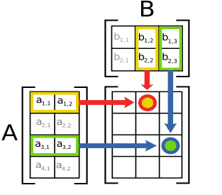
Matrix Multiplication
1. (7.1) Matrix Arithmetic
Heuristically, let A be 4x2 and B be 2x3. Then

Slide 19
Matrix Multiplication
1. (7.1) Matrix Arithmetic
Let’s revisit example 7.2: Let A and B be the following matrices. This time, instead of finding AB, we calculate BA:
Solution:
Note: (3x2) (2x3) = (3x3)
Note: In this case BA is defined, but it is obviously not equal to AB.

Slide 20

Matrix Multiplication
1. (7.1) Matrix Arithmetic
Example 7.3:
Let Does the product Ax exist?
If so what is it? Does the product xA exist? If so what is it?
Solution: Notice that x is a vector. We can think of a vector as a matrix that only has one column. So, x is a 2x1 matrix. The process for multiplication remains the same.
First we check if the product Ax is possible under matrix multiplication:

Slide 21

Matrix Multiplication
1. (7.1) Matrix Arithmetic
So the product is defined and we have:
Now, we check if the product xA is possible under matrix multiplication:
Thus, the matrix multiplication xA is not defined.

Slide 22
Example 7.4.1 (Example 6.4 version 3.0)
2. (7.2) Applications
Recall our simple model for ecological succession of a coastal wetlands:
We are now in a position to justify that the above matrix equation does what we want it to do. We found that if
, then and .

Slide 23
Example 7.4.1 (Example 6.4 version 3.0)
2. (7.2) Applications
We now calculate these using matrix-vector multiplication:
While this is a marked improvement over our previous method, it is still not ideal; for example, what if I would like to know the wetland composition after 12 decades?

Slide 24
2. (7.2) Applications
To find the wetland composition after 12 decades, the present method requires us to use the vector for the wetland composition after 11 decades:
But, to find the wetland composition after 11 decades, we’ll need to find the vector for the wetland composition after 10 decades:

Slide 25
2. (7.2) Applications
It’s easy to see where this is going- if we want to find the wetland composition after, say, t decades, the present method requires us to know the vectors for the wetland composition for all previous decades back to the initial composition vector
Let’s see if we can find an even better method:
?

Slide 26
Example 7.4.2 (Example 6.4 version 4.0)
2. (7.2) Applications
The questioned equality on the previous slide is, indeed, true; that is, matrix-matrix multiplication does what we want it to do
We illustrate this by, once again, finding the wetland composition vector after 2 decades:

Slide 27
Example 7.4.2 (Example 6.4 version 4.0)
2. (7.2) Applications
We’ll calculate that product step by step for practice:

Slide 28
Example 7.4.2 (Example 6.4 version 4.0)
2. (7.2) Applications
We’ll calculate that product step by step for practice:

Slide 29
Example 7.4.2 (Example 6.4 version 4.0)
2. (7.2) Applications
We’ll calculate that product step by step for practice:

Slide 30
Example 7.4.2 (Example 6.4 version 4.0)
2. (7.2) Applications
Now back to the problem:
Just as before!

Slide 31
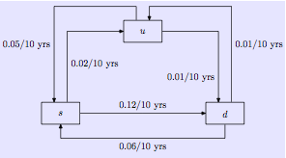
Example 7.5 (Example 6.5 version 2.0)
2. (7.2) Applications
Recall:

Slide 32
Example 7.5 (Example 6.5 version 2.0)
2. (7.2) Applications
We find the wetland composition after 2 decades for this more complex ecological succession model:
Let’s use MATLAB to do the heavy lifting this time:

Slide 33
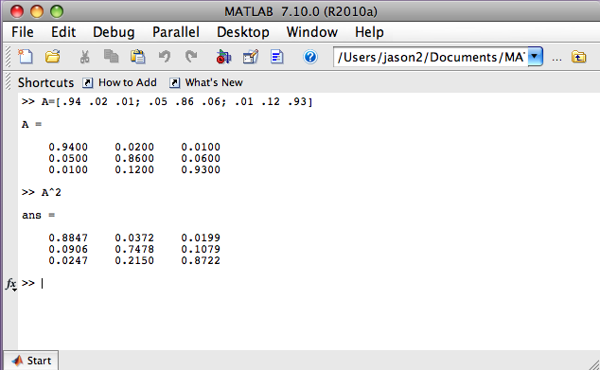
Example 7.5 (Example 6.5 version 2.0)
2. (7.2) Applications

Slide 34
Example 7.5 (Example 6.5 version 2.0)
2. (7.2) Applications
And we have:

Slide 35
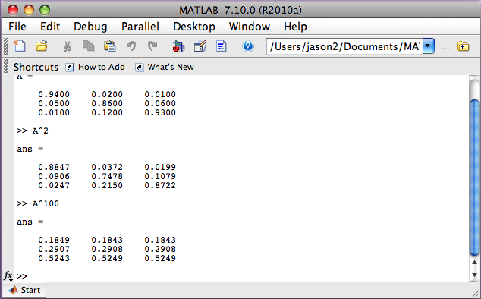
Example 7.5 (Example 6.5 version 2.0)
2. (7.2) Applications
It’s just as easy for MATLAB
to calculate the 100th
power of a matrix

Slide 36
Example 7.5 (Example 6.5 version 2.0)
2. (7.2) Applications
Hence:
What appears to be happening?

Slide 37
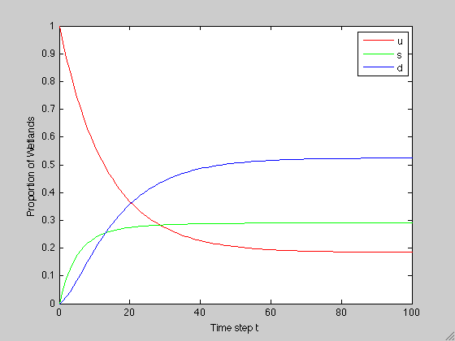
Example 7.5 (Example 6.5 version 2.0)
2. (7.2) Applications
Next week we will be writing an m-ﬁle that plots time series data for an ecological succession model
For this problem, the output for the first 100 decades is:

Slide 38
Homework
Chapter 6: 6.2-6.6
Chapter 7: 7.1-2, 7.4-7.8
Quiz 3: Covers chapters 5, 6 and 7
Find the general solution for one of each of the three cases we considered
There will be a problem similar to Exercise 5.8
Given a flow diagram, construct the transfer matrix
Give an ecological interpretation of each entry of the transfer matrix
Construct an initial composition vector from given information
Formulate an equation for finding the composition vector after t time steps
Calculate (by hand) the composition vector after 1 and after 2 time steps

