Slide 1
Chapter 6: Vectors & Matrices
Introduction to Unit 2
(6.1) Vector Structure
(6.2) Vector Algebra
(6.3) Dynamics: Vectors Changing Over Time

Slide 2
Biological Motivation
1. Introduction to Unit 2
Biological objects of interest have structure that suggest to us the way those objects should be analyzed, for example:
various components of cells, e.g. chemical composition
cellular composition of tissues
tissue composition of individual organisms
composition of different individuals which make up a population, e.g. demographic structure (gender, age, location, economic status) or epidemiological structure (susceptible, infected, recovered)
species which make up a community
types of habitat across a landscape
In this unit we will discuss mathematical concepts that provide a way to describe the structure/composition of these biological objects and a mechanism to analyze how the composition might change through time or across space (dynamics)

Slide 3
A Guiding Example
1. Introduction to Unit 2
A motivating example that we will use regularly in this unit concerns patterns of species across a landscape
Think of taking aerial photographs of a plot of land once each decade and analyzing the changes in certain patterns across the landscape
Plant composition (deciduous hardwoods, herbaceous, grassland, etc.)
Land use composition (agricultural, urban, suburban, etc.
One descriptive summary you might use for the landscape is to describe it by the fraction of the total area which is covered by each of the different land uses

Slide 4
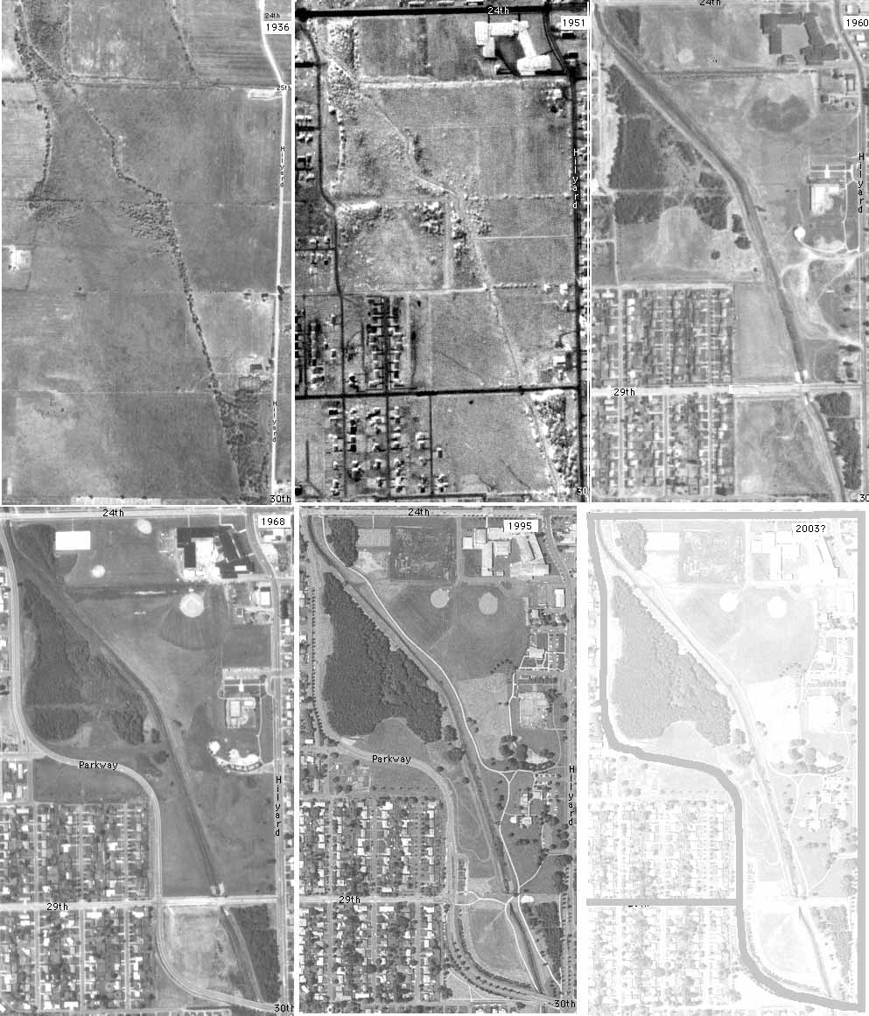
A Guiding Example
1. Introduction to Unit 2

Slide 5
Biological Motivation
1. Introduction to Unit 2
A description of this landscape at a particular time could use a list of numbers giving the fraction of the landscape for each use… in other words a vector of numbers which sum to one
As time goes on (e.g. we take a picture of the landscape every decade), the vector describing the fraction covered by each type of organism will change
If we could determine the rules by which this vector changes, we would have a basis for a model of the landscape’s dynamics (called succession in ecology)
From this model we might then be able to determine from just a few decades of pictures, what the landscape might look like many decades from now (the process we called extrapolation when we were talking about regressions)

Slide 6
Definition
2. (6.1) Vector Structure
Thus far we have been working with univariate and bivariate data:
The dataset in Example 1.1 was simply a list of recorded pulse rates (univariate)
If we make two measurements- like the pulse rate and the time of day- then we have bivariate data and we can represent each pair as a data point; that is, an ordered pair
Ordered pairs are vectors
Notice the word “order” is important; that is, order is important. The data point (1,3) is not the same as (3,1)
More generally, a vector is an ordered n-tuple
Notation:

Slide 7
Example 6.1
2. (6.1) Vector Structure
Suppose we were asked to construct a vector that would represent the composition of a coastal wetlands landscape… what would that mean?
First, we would have to decide what classes make up a coastal wetlands
Coastal wetlands are areas near the coast where the soil is submerged or soaked with moisture either permanently or seasonally
Coastal wetlands are found between areas that are always wet (i.e. oceans, seas, bays, and estuaries), and areas that are always dry (i.e. grasslands and forests)
We could divide wetlands up into land that is submerged underwater, and land that is not submerged (two classes)
However, we might decided that having two classes is not enough to accurately describe the variation in landscape in the wetlands. Thus, it might be appropriate to introduce a third class, land that is not submerged, but heavily saturated with moisture

Slide 8
Example 6.1
2. (6.1) Vector Structure
After we decide what the classes are we must decide how to order them: we will use the order: submerged, saturated but not submerged, dry
If we let:
u = proportion of wetlands that are submerged or under water
s = proportion of wetlands that are not submerged but saturated with moisture
d = proportion of wetlands that are dry, then the vector v representing the coastal wetlands composition would be:
If at some particular time t, 65% of
the wetlands were submerged, 30%
saturated, and 5% dry, then we’d have:

Slide 9
Example 6.1
2. (6.1) Vector Structure
Alternatively, we could divide wetlands up into the types of plants that grow there
For example, the types of ﬂora that grow in the Queensland coastal wetland in Australia are: mangroves, seagrasses, grasses, sedges/rushes, ferns, wet heaths, trees and shrubs, and saltmarsh plants
This would give 8 classes. Just as above, we could construct and ordering for these classes and then construct a vector representing the composition of the Queensland coastal wetlands based on the proportion of the total area in which each of the above type of fauna grows

Slide 10
Addition & Scalar Multiplication
3. (6.2) Vector Algebra
Let v, w be n-tuples and c a scalar (number). Then we define:
Vector addition:
Scalar Multiplication:

Slide 11
Example 6.2
3. (6.2) Vector Algebra
In Example 6.1 we formed a vector to describe the structure of a coastal wetlands at a particular time t. The elements of the vector were proportions of the total area that were submerged, saturated, and dry. Suppose we knew the total area of the landscape to be 160 hectares. How would we determine how many hectares were in each of the three classes?
Solution:

Slide 12
Example 6.3
3. (6.2) Vector Algebra
Suppose we were managing some national park. For the entire park the ﬂora composition is: 8% annual plants, 23% perennial plants and grasses, 26% shrubs, 24% softwood trees and pines, and 19% hardwood trees. The total area of the park is 1,250 hectares. The park is now considering purchasing 300 hectares of farmland located next to the park of which 5% is annual plants, 90% is perennial plants and grasses, and 5% is softwood trees and pines. If the national park acquires this new land, what will be the new ﬂora composition for the park?
Solution: We are given the
classes, so we first need to
decide on an order:

Slide 13
Example 6.3
3. (6.2) Vector Algebra
We are given the current composition information for the park and the farm:
Notice that we should not directly add these two vectors. Why?
We must convert both vectors to hectare units, then it makes sense to add the vectors:

Slide 14
4. (6.3) Dynamics: Vectors Changing Over Time
Consider again our coastal wetlands example:
u = proportion of wetlands that are submerged or under water
s = proportion of wetlands that are not submerged but saturated with moisture
d = proportion of wetlands that are dry, then the vector v representing the coastal wetlands composition would be:

Slide 15
Example 6.4 (Ecological Succession: Simple Case)
4. (6.3) Dynamics: Vectors Changing Over Time
Suppose we were looking at a total area of 100 hectares which is all currently submerged wetlands
Every 10 years:
5% of submerged wetlands become saturated wetland
12% of saturated wetlands become dry
100% of dry wetlands remain dry
After 10 years, how much of the land is submerged, how much is saturated, and how much is dry?
After 20 years?

Slide 16
Example 6.4 (Ecological Succession: Simple Case)
4. (6.3) Dynamics: Vectors Changing Over Time
First we write out the initial composition vector:
Next, we find the composition vector after 10 years:
Submerged:
Saturated:
Dry:
Hence:

Slide 17
Example 6.4 (Ecological Succession: Simple Case)
4. (6.3) Dynamics: Vectors Changing Over Time
To find the composition after 20 years, we use v(10):
Next, we find the composition vector after 20 years:
Submerged:
Saturated:
Dry:
Hence:

Slide 18
Example 6.4 version 2.0
4. (6.3) Dynamics: Vectors Changing Over Time
Let’s try to be a bit more economical with this process:
Rewriting, we have:

Slide 19
Example 6.4 version 2.0
4. (6.3) Dynamics: Vectors Changing Over Time
If we form an array of only the numbers, we obtain the coefficient matrix:
Comments:
This is a matrix; specifically it is a 3x3 matrix
Each column sums to 1
Diagonal entries represent proportions of each class that stay in that class each time step
Off-diagonal entries represent proportions of each class that move to other classes each time step:

Slide 20
Example 6.4 version 2.0
4. (6.3) Dynamics: Vectors Changing Over Time
One can think of the coefficient matrix in the following way:
moving from
moving into
For this reason, the coefficient matrix sometimes called a transfer matrix

Slide 21

Example 6.4 version 2.0
4. (6.3) Dynamics: Vectors Changing Over Time
Rewriting again:
Comments:
The equation above involves matrix multiplication; to be discussed in Chapter 7
Transfer matrices can be represented by a flow diagram:

Slide 22
Modeling Structural Change in General
4. (6.3) Dynamics: Vectors Changing Over Time
We now write this more generally; suppose we have n classes to our landscape:
Then we can write the vector describing the composition of the landscape (composition vector) at time step t as:
where the k^{th} entry, v_{k}(t), is the proportion of the landscape that is class k at time t
Since these are proportions, we have:

Slide 23
Modeling Structural Change in General
4. (6.3) Dynamics: Vectors Changing Over Time
We now write this more generally; suppose we have n classes to our landscape:
Next, we create an array with n rows and n columns, i.e. an n × n matrix:
where a_{ij} is the proportion of class j that becomes or moves into class i (i.e., this is a transfer matrix)
We must have the entries of each column of matrix A sum to 1:

Slide 24
Modeling Structural Change in General
4. (6.3) Dynamics: Vectors Changing Over Time
We now write this more generally; suppose we have n classes to our landscape:
Now we can describe the composition of the landscape at time step t + 1 as:
Or very succinctly:
These are our dynamic equations

Slide 25
Example 6.5
4. (6.3) Dynamics: Vectors Changing Over Time
Suppose we want to model how the composition of a coastal wetlands changes over time.
Again, we will structure the wetlands into submerged, saturated, and dry.
After a couple decades of data collection we know that every 10 years:
5% of submerged wetlands become saturated
1% of submerged wetlands become dry
12% of saturated wetlands become dry
2% of saturated wetlands become submerged again
6% of dry wetlands become saturated again
1% of dry wetlands become submerged again

Slide 26
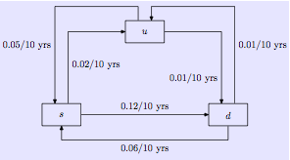
Example 6.5
4. (6.3) Dynamics: Vectors Changing Over Time
It is convenient to summarize this information with a flow diagram:
We want to find the matrix that describes how the composition of these coastal wetlands change every 10 years.

Slide 27
Example 6.5
4. (6.3) Dynamics: Vectors Changing Over Time
u s d
u
s
d

Slide 28
Example 6.5
4. (6.3) Dynamics: Vectors Changing Over Time
u s d
u
s
d

Slide 29
Example 6.5
4. (6.3) Dynamics: Vectors Changing Over Time
u s d
u
s
d

Slide 30
Example 6.5
4. (6.3) Dynamics: Vectors Changing Over Time
u s d
u
s
d

Slide 31
Example 6.5
4. (6.3) Dynamics: Vectors Changing Over Time

Slide 32

Homework Problem: Exercise 6.5
4. (6.3) Dynamics: Vectors Changing Over Time
Construct the transfer matrix that describes the following ﬂow diagrams:
(a)
S I
This ﬂow diagram represents the dynamics of a non-fatal disease with susceptible (S) and infected (I) classes

Slide 33
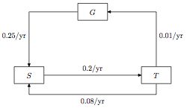
Homework Problem: Exercise 6.5
4. (6.3) Dynamics: Vectors Changing Over Time
Construct the transfer matrix that describes the following ﬂow diagrams:
(b)
This ﬂow diagram represents the dynamics of ecological succession with classes for grass (G), shrubs (S), and trees (T)
G S T

Slide 34
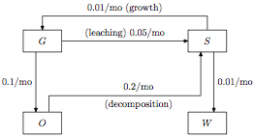
Homework Problem: Exercise 6.5
4. (6.3) Dynamics: Vectors Changing Over Time
Construct the transfer matrix that describes the following ﬂow diagrams:
(c)
This ﬂow diagram represents the dynamics of strontium 90 cycling through an ecosystem. The ecosystem is divided into grasses (G), soil (S), streams (W), and dead organic matter (O).
G S O W

Slide 35
Homework
Chapter 6: 6.2-6.6

