Slide 1
Lecture 1: Basic Descriptive Statistics
Types of Biological Data
Summary Descriptive Statistics
Measures of Central Tendency
Measures of Dispersion
Assignments

Slide 2
Scales of Measurement: General Comments
1. Types of Biological Data
Any observation or experiment in biology involves the collection of information (observe plants)
Empirical observations become statistical data once they are cast as some type of measurement (plant height)
Measurement is the assignment of numbers to objects or events according to rules (measure plant 1, plant 2, … )
Different rules lead to different kinds of scales of measurement
A dataset can thus be classified according to the type of scale by which it is measured
Different scales admit different permissible statistics (see table summary)

Slide 3
Scales of Measurement: General Comments
1. Types of Biological Data

Slide 4
Scales of Measurement: NOIR
1. Types of Biological Data
Data on a Nominal Scale
A nominal scale assigns numbers as mere labels or types- words or letters would work just as well
Example: numbers on jerseys that serve to identify athletic participants
Example: rocks can be classified as igneous, sedimentary, and metamorphic
Data on an Ordinal Scale
An ordinal scale assigns numbers according to some rank ordering
Example: order in which participant’s finish a race (1st, 2nd, … )

Slide 5
Scales of Measurement: NOIR
1. Types of Biological Data
Data on an Interval Scale
An interval scale assigns numbers according to some rank ordering and assigns the size of intervals in between data (but has no true zero point)
Example: The temperature scales of degrees Celsius and degrees Fahrenheit are interval scales
The amount of temperature change from 27° C to 32° C is the same as the temperature change from 104° C to 109° C
The choices for 0° C and 0° F are arbitrary; that is, it makes no sense to say that 98° F is twice as hot as 49° F
Data on a Ratio Scale
A ratio scale is an interval scale with a true zero point.
Example: A participant’s finish time for a race
A finish time of 25 seconds is better than 50 seconds (order) and is, indeed, twice as fast (true zero)
Example: The Kelvin temperature scale (has an absolute zero)

Slide 6
Discrete vs. Continuous
1. Types of Biological Data
Measurements may take on discrete or continuous values:
A set of values is discrete if it is countable
Set of possible number of arms on a starfish
Set of possible number of leaves on a plant
Set of possible number of granules of sand on a beach
A set of values is continuous if it is uncountable
Set of possible weights of starfish
Set of possible surface areas for leaves
Set of possible amounts of time spent counting sand granules

Slide 7
Summary: Organizational Chart
1. Types of Biological Data

Slide 8
Overview
2. Summary Descriptive Statistics of Datasets
When a dataset is summarized by its statistical information, there is a loss of information. That is, given the summary statistics, there is no way to recover the original data.
Basic summary statistics may be grouped as:
measures of central tendency (giving in some sense the central value of a data set)
measures of dispersion (giving a measure of how spread out that data set is)

Slide 9
Measures of Central Tendency
2. Summary Descriptive Statistics of Datasets
Arithmetic Mean
Dataset:
Average:
Example:
This statistic doesn’t make sense for data on nominal or ordinal scales: jersey numbers, top ten list

Slide 10
Measures of Central Tendency
2. Summary Descriptive Statistics of Datasets
Median: half the dataset fall below this value; half above
Dataset:
Median:
This statistic doesn’t make sense for data on nominal scales: jersey numbers
The median is less effected by outliers than the mean; in this case the mean is approximately 167,000

Slide 11
Measures of Central Tendency
2. Summary Descriptive Statistics of Datasets
Mode: The mode is the most frequently occurring value (or values - there may be more than one) in a data set
Dataset:
Mode:
This statistic is meaningful for all scales

Slide 12
Measures of Central Tendency
2. Summary Descriptive Statistics of Datasets
Midrange: The midrange is the value halfway between the largest and smallest values in the data set
Dataset:
Midrange:
This statistic doesn’t make sense for data on nominal or ordinal scales: jersey numbers, top ten list

Slide 13
Measures of Central Tendency
2. Summary Descriptive Statistics of Datasets
Geometric Mean: The geometric mean of a set of n data is the n^{th} root of the product of the n data values,
Dataset:
Geometric Mean:
The geometric mean arises as an appropriate estimate of growth rates of a population when the growth rates vary through time or space
It is always less than or equal to the arithmetic mean

Slide 14
Measures of Dispersion
2. Summary Descriptive Statistics of Datasets
Range
Dataset:
Range:
Variance: the mean sum of the squares of the deviations of the data from the arithmetic mean
The “best” estimate of this (take a good statistics class to find out how “best” is defined) is the sample variance:
Standard Deviation:

Slide 15
Table Summary
2. Summary Descriptive Statistics of Datasets
Permissible Statistic/Operation | Nominal | Ordinal | Interval | Ratio
Mode | ✓ | ✓ | ✓ | ✓
Median | ✗ | ✓ | ✓ | ✓
Addition, Mean, Variance | ✗ | ✗ | ✓ | ✓
Multiplication, Ratio | ✗ | ✗ | ✗ | ✓

Slide 16
Homework, MATLAB
3. Assignments
Homework: Chapter 1 Exercises 1.2 - 1.5.
Download MATLAB as soon as possible. We will begin working with MATLAB in class next Thursday.

Slide 17
1.1
Homework
Exercise capacity (in seconds) was determined for each of 11 patients who were being treated for chronic heart failure: 906, 1320, 711, 1170, 684, 1200, 837, 1056, 897, 882, 1008
Determine the mean and the median of the data.
Solution:
To find the median, we first order the data:
684, 711, 837, 882, 897, 906, 1008, 1056, 1170, 1200, 1320
Since there are eleven (an odd number) data points, the median will be the 6th data point. That is, the median is 906.

Slide 18
1.2
Homework
Daily crude oil output (in millions of barrels) is shown below for the years 1971 to 1990.
9.45 9.40 9.25 8.75 8.30 8.10 8.25 8.70 8.55 8.60
8.55 8.65 8.70 8.70 8.91 8.60 8.20 7.70 7.20 6.75
Compute the mean, median, and mode for the data.
Solution: Let’s use MATLAB to solve this problem.

Slide 19
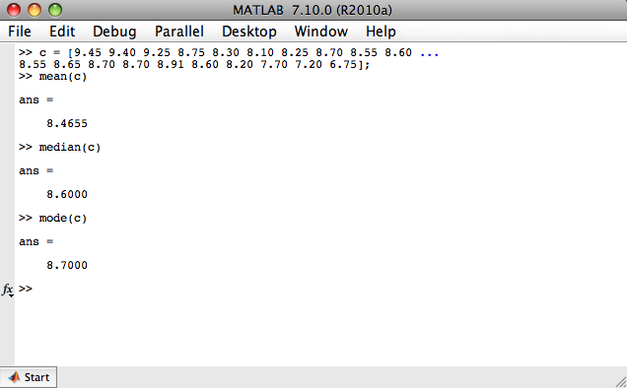
1.2
Homework

Slide 20
1.4
Homework
Ten hospital employees on a standard American diet agreed to adopt a vegetarian diet for one month. Below is the change in the serum cholesterol level (before - after).
49, −10, 27, 13, 36, 19, 48, 21, 8, 16
Compute the median and mean change in cholesterol.
Compute the range, variance and standard deviation of the data. Is the data fairly spread out or close together?
Solution: Again we use MATLAB.

Slide 21
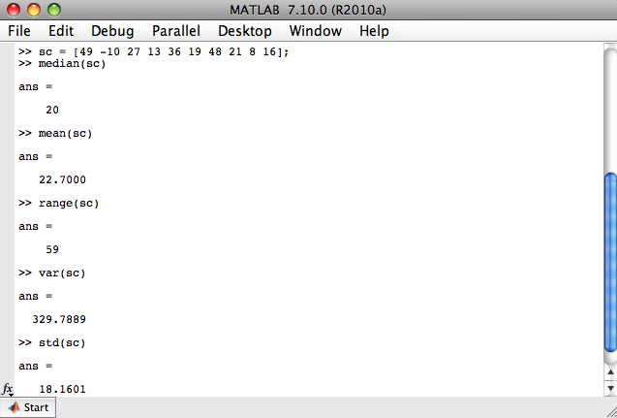
1.4
Homework

Slide 22
1.4
Homework
In order to study for the quiz, we now do these by hand. First we rewrite the dataset in numerical order:
-10, 8, 13, 16, 19, 21, 27, 36, 48, 49
Since there are ten (an even number) data points, the median will be halfway between 19 and 21. That is, the median is 20. Finding the variance is more work:

Slide 23
1.5
Homework
Twelve sheep were fed pingue as a part of an experiment and died as a result. The time of death in hours after the administering of pingue for each sheep follows:
44 27 24 24 36 36 44 120 29 36 36 36
Compute the range, variance and standard deviation of the sample.
Answer:
range: 96
variance: 663.8182
std: 25.7647

